Slide 1
Queue
Alemitu M.

Slide 2
Introduction to the Queue ADT
Like a stack, a queue (pronounced "cue") is a data structure that holds a sequence of elements.
A queue, however, provides access to its elements in first-in, first-out (FIFO) order.
The elements in a queue are processed like customers standing in a bank: the first customer in line is the first one served.

Slide 3
Static and Dynamic Queues
Just as stacks are implemented as arrays or linked lists, so are queues.
Dynamic queues offer the same advantages over static queues that dynamic stacks offer over static stacks.

Slide 4
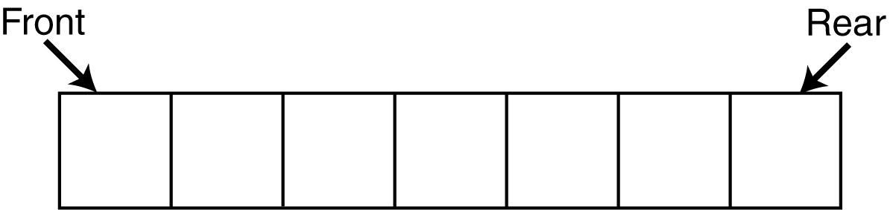
Queue Operations
Think of queues as having a front and a rear.

Slide 5
Queue Operations
The two primary queue operations are enqueuing and dequeuing.
To enqueue means to insert an element at the rear of a queue.
To dequeue means to remove an element from the front of a queue.

Slide 6
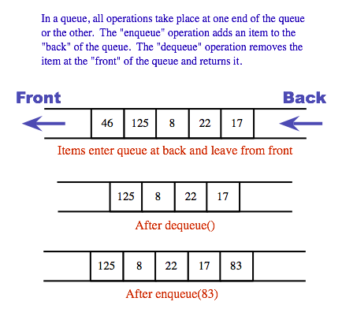
Queue Operations

Slide 7
Queue Operations
Suppose we have an empty static integer queue that is capable of holding a maximum of three values.
With that queue we execute the following enqueue operations.
Enqueue(3);
Enqueue(6);
Enqueue(9);

Slide 8
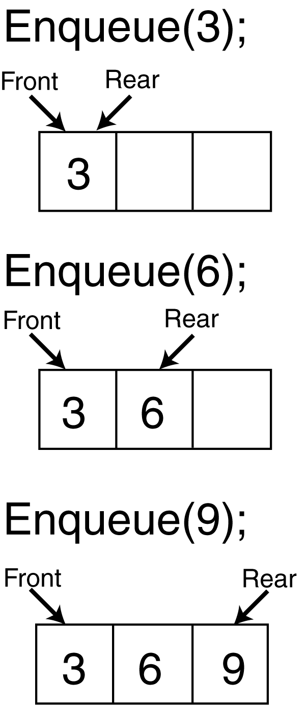
Queue Operations
the state of the queue after each of the enqueue operations.

Slide 9
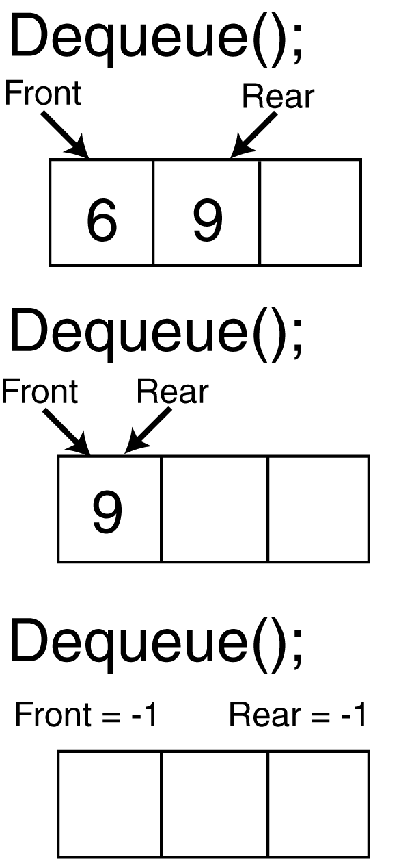
Queue Operations
Now let's see how dequeue operations are performed.
the state of the queue after each of three consecutive dequeue operations , figure
An empty queue can be signified by setting both front and rear indices to –1.

Slide 10
Other Operations
initialize():
Initialize the queue to be empty.
isFull():
Determine if queue is full or not. A Boolean operation needed for static queues. Returns true if the queue is full. Otherwise, returns false.
isEmpty():
Determine whether queue is empty or not. A Boolean operation needed for all queues . Returns true if the queue is empty. Otherwise, returns false.
display():
If the queue is not empty then retrieve all elements.

Slide 11
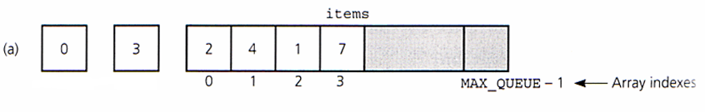
Array Based Implementation
Array: items[]
Variables:
front
rear
MAX_QUEUE
front
rear

Slide 12
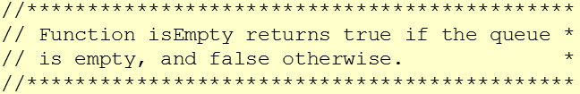
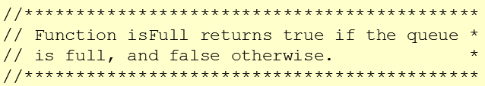
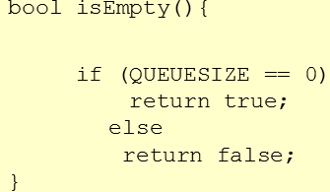
Array Based Implementation
………
int NumArray[]; int MAX_SIZE; int FRONT= -1; int REAR= -1; int QUEUESIZE=0;
………
bool isFull(){
if (REAR<MAX_SIZE-1)
return false;
else
return true;
}

Slide 13
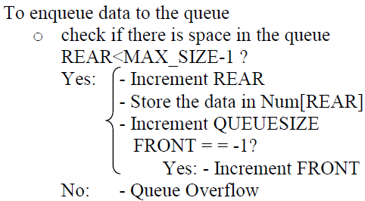
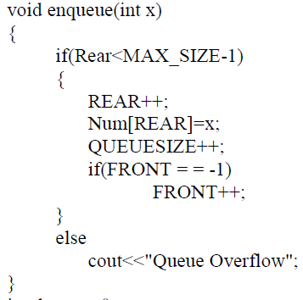
Array Based Implementation: Enqueue
Algorithm
Implementation

Slide 14
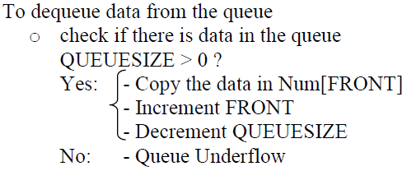
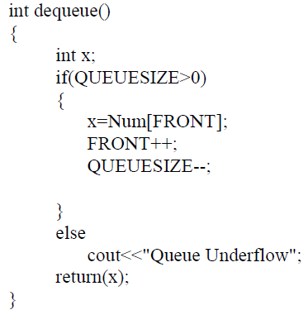
Array Based Implementation: Dequeue
Algorithm
Implementation

Slide 15
Circular Array Implementation of Queues
A problem with simple arrays is we run out of space even if the queue never reaches the size of the array.
Thus, circular arrays can be used to solve this problem.
Freed spaces are re-used to store data

Slide 16
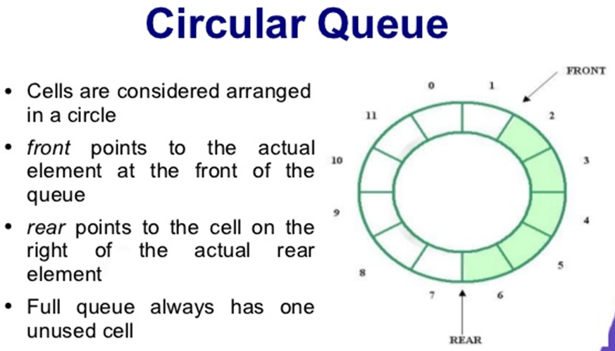

Slide 17
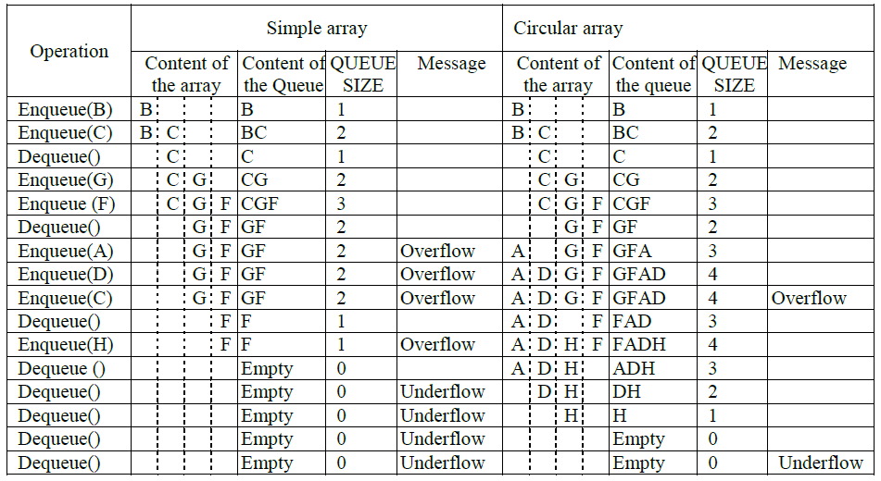
Example: Consider a queue with MAX_SIZE = 4

Slide 18
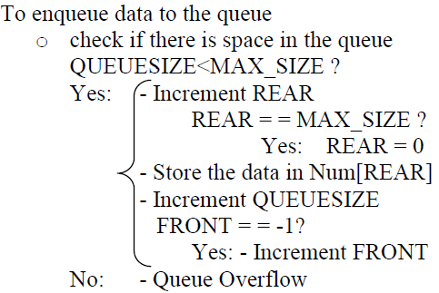
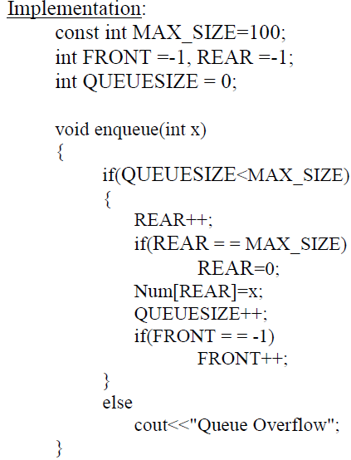

Slide 19
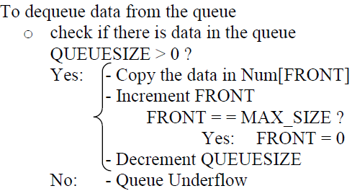

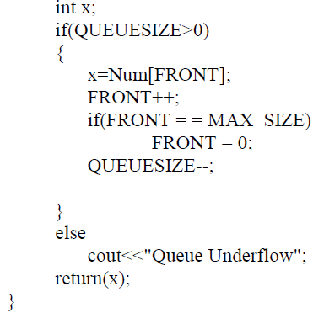

Slide 20
Linked List Implementation of Queues
Enqueue- is inserting a node at the end of a linked list
Dequeue- is deleting the first node in the list

Slide 21
Reading Assignment
Deque
Double ended queue
insertion and deletion can occur at either end
Priority Queue
each data has an associated key that is provided at the time of insertion
Dequeue operation deletes data having highest priority in the list

Slide 22
Applications of Queues
Print server - maintains a queue of print jobs
Disk Driver - maintains a queue of disk input/output requests
Task scheduler in multiprocessing system- maintains priority queues of processes
Telephone calls in a busy environment –maintains a queue of telephone calls
Simulation of waiting line - maintains a queue of persons

